Slide 1
County Population Data and Projections
Brian Engelmann, County Demographer

Slide 2
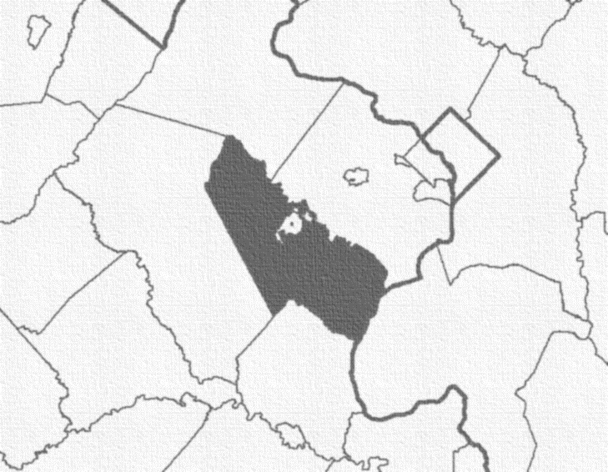
County Profile 2020 Census
Population: 482,204
Area: 347.3 sq. mi.
Density: 1,388.4 people/sq. mi.
Housing Units: 158,525
Occupied: 153,745
Vacant: 4,780 (3%)
Group Quarters: 3,812 people in 67 facilities
Age
Under 18: | 128,802 31.1%
18 and over: | 353,402 73.3%
Race & Ethnicity
Hispanic or Latino (of any race): | 121,524 | 25.2%
Not Hispanic or Latino | 360,680 | 74.8%
White: | 185,048 | 38.4%
Black or African American: | 94,939 | 19.7%
American Indian and Alaska Native: | 745 | 0.2%
Asian: | 49,836 | 10.3%
Native Hawaiian and Other Pacific Isl: | 507 | 0.1%
Other: | 3,384 | 0.7%
Two or more races: | 26,221 | 5.4%

Slide 3
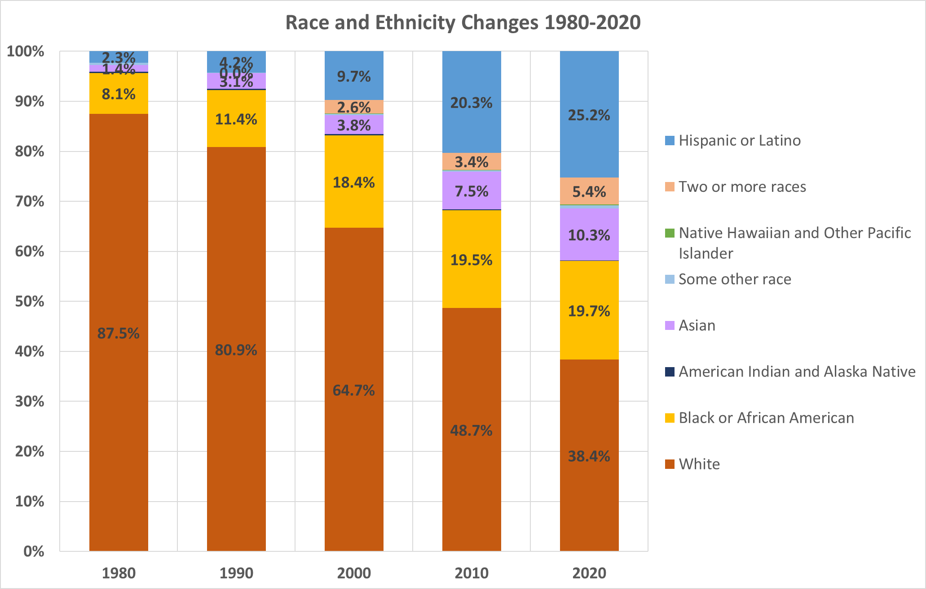
Decennial Census Changes

Slide 4
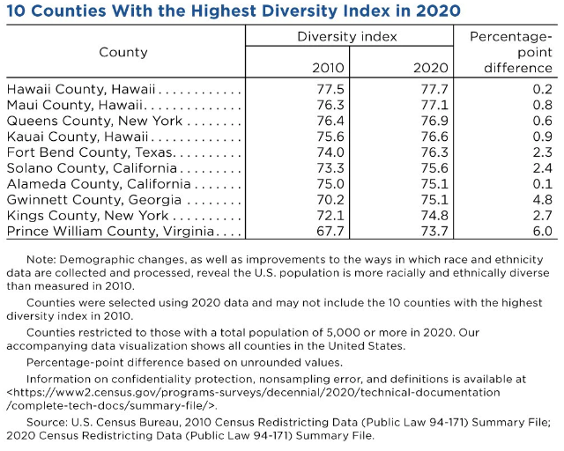
Diversity Index
https://www.census.gov/library/stories/2021/08/2020-united-states-population-more-racially-ethnically-diverse-than-2010.html
Notes:
This index shows the probability that two people chosen at random will be from different race and ethnic groups.
The DI is bounded between 0 and 1, with a zero-value indicating that everyone in the population has the same racial and ethnic characteristics, while a value close to 1 indicates that everyone in the population has different characteristics. We converted the probabilities into percentages to make the results easier to interpret. In this format, the DI tells us the chance that two people chosen at random will be from different racial and ethnic groups.
Virginia: 60.5%
The following groups are used in the diversity calculations:
Hispanic
White alone, non-Hispanic
Black or African American alone, non-Hispanic
American Indian and Alaska Native alone, non-Hispanic
Asian alone, non-Hispanic
Native Hawaiian and Other Pacific Islander alone, non-Hispanic
Some Other Race alone, non-Hispanic
Multiracial, non-Hispanic

Slide 5
County Profile
2016-2020 American Community Survey 5-Year Estimates
Other:
Households that speak a language other than English at home: | 34.3%
Percent below poverty level: | 6.1%
Median household income: | $107,707
Population age 25+ with bachelor's degree or higher: | 41.9%
Place of Birth
Born in U.S.: | 71.7%
State of residence: | 35.6%
Different state: | 36.1%
P.R., islands, abroad: | 3.0%
Foreign born: | 25.3%
Place of Work for Age 16+
Work in Prince William: | 39.9%
Work in VA, outside of Prince William: | 48.2%
Work in another state: | 11.9%
Mean travel time to work (minutes): | 39.8
Commuting
Drove alone: | 73.1%
Carpooled: | 11.2%
Public Transportation: | 4.4%
Work from home: | 8.0%
Other: | 3.3%

Slide 6
Population and Housing Change: 2000-2021
Decennial Census Data (US Census Bureau)
 | Population | Housing Units | Households | Occupancy Rate | Avg. Household Size | Group Quarters
2000 Census | 280,813 | 98,052 | 94,570 | 96.45 | 2.94 | 2,389
2010 Census | 402,002 | 137,115 | 130,785 | 95.38 | 3.05 | 2,520
2020 Census | 482,204 | 158,525 | 153,745 | 96.98 | 3.12 | 3,018
PWC Biannual Estimates
 | Population | Housing Units | Households | Occupancy Rate | Avg. Household Size | Group Quarters
2020 Q4 | 486,504 | 158,010 | 153,837 | 97.36 | 3.14 | 3,812
2021 Q2 | 488,629 | 158,706 | 154,521 | 97.36 | 3.14 | 3,812
2021 Q4 | 490,250 | 159,255 | 155,014 | 97.34 | 3.14 | 3,812

Slide 7
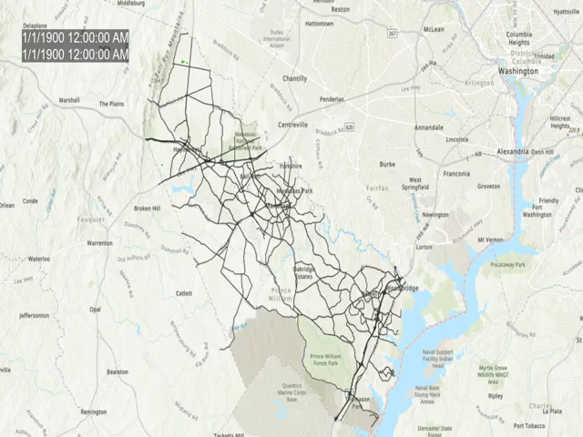
Residential Structures by Year Built: 1900-2021
Growth animation too big to display when shared via email

Slide 8
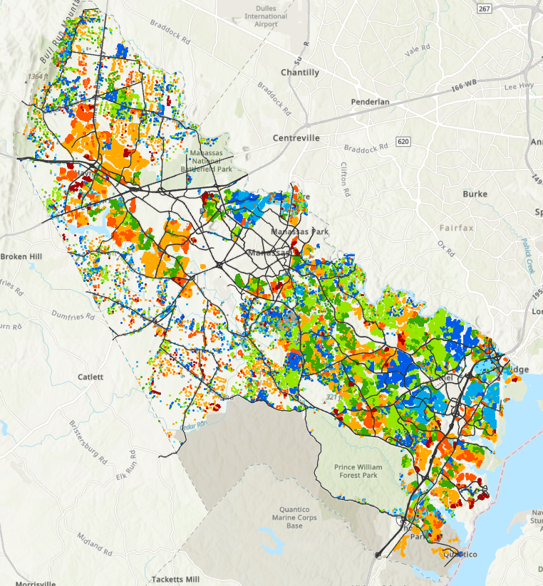
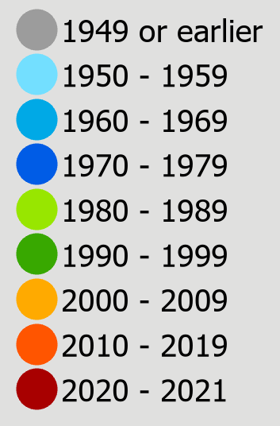
Residential Structures by Decade Built

Slide 9
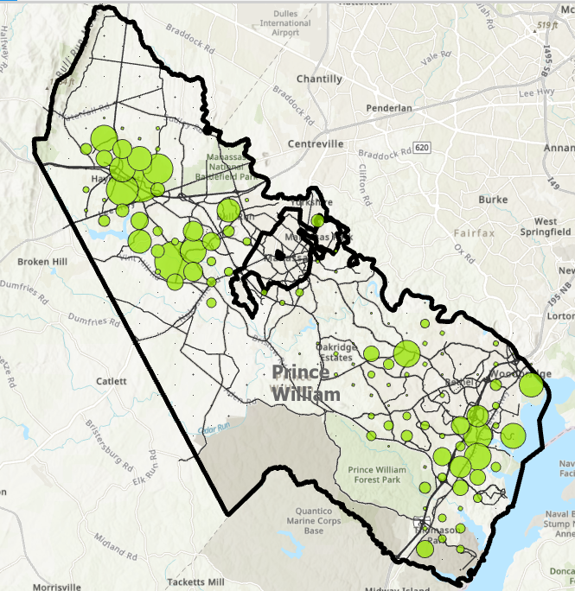
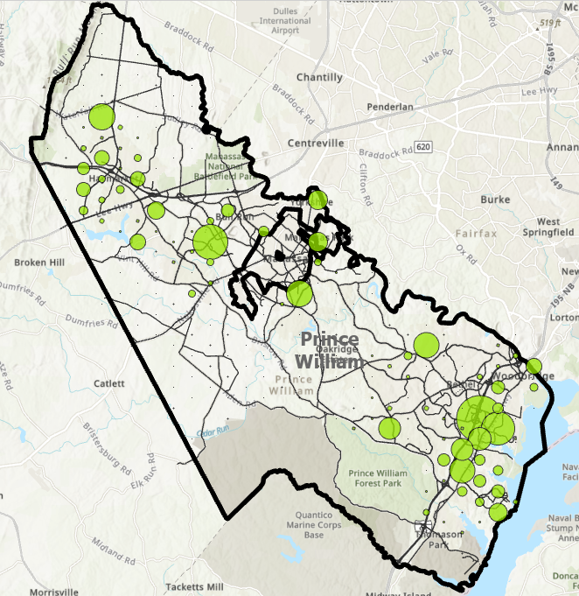
Change in Housing Units
2000-2009
2010-2021

Slide 10
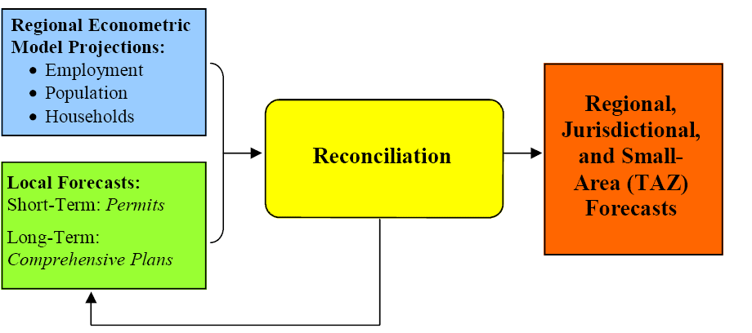
MWCOG Forecast Process

Slide 11
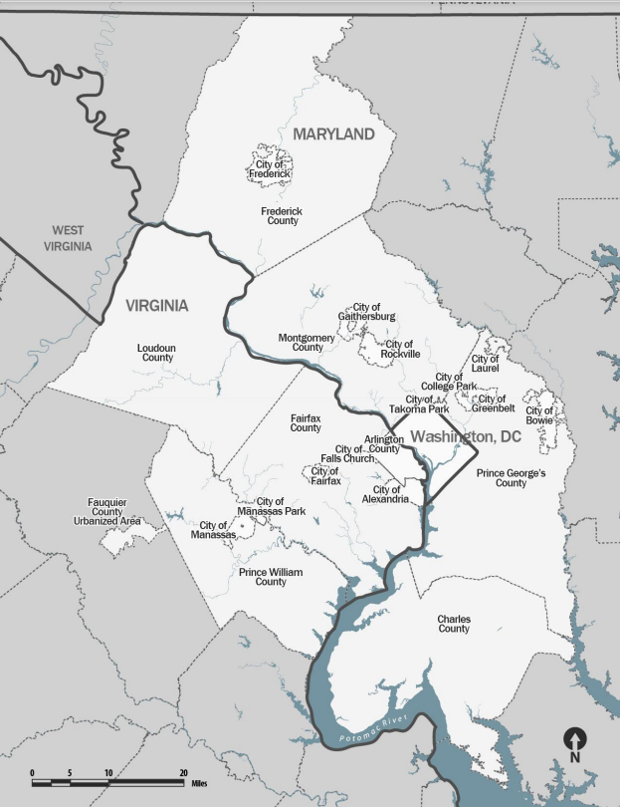
MWCOG Region

Slide 12
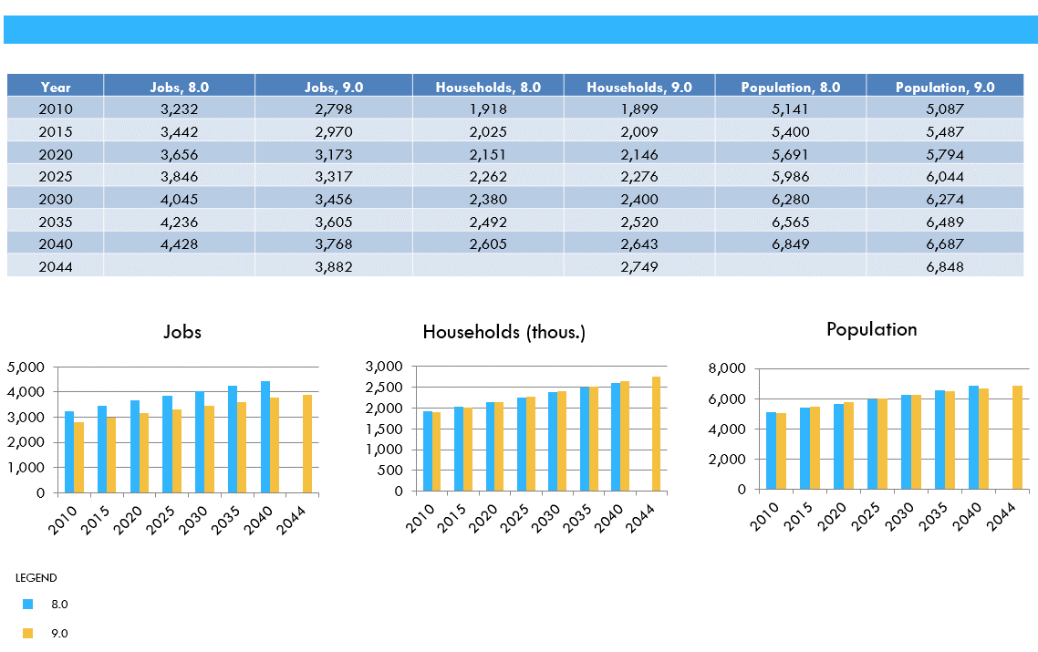
Econometric Model

Slide 13
MWCOG Forecast Process
Households:
Assumes Logistic Curve with an upper limit 220,000 HH
Constrained by Comprehensive Plan
Reflects larger multi-family growth
Long-term decline of single-family growth rate
Future model: vacancy Rate will shrink to 3.0% (2020 Census)
Population:
Average household size by unit type applied, will increase to more than 3.12 (2020 Census) in future model
Employment:
Assumes PWC as a % of MSA will continue to grow
Model updated with latest at-place employment data

Slide 14
COG 9.2: Prince William
 | Households | Population | Employment
2015 | 142,900 | 444,800 | 143,000
2020 | 151,000 | 468,400 | 164,800
2025 | 167,100 | 504,200 | 184,400
2030 | 176,900 | 530,300 | 203,800
2035 | 185,200 | 551,600 | 222,500
2040 | 191,800 | 569,200 | 240,900
2045 | 197,100 | 582,700 | 257,000
Change: 2015-2045 | 54,200 | 137,900 | 114,000
% Change: 2015-2045 | 37.9% | 31.0% | 79.7%
% Of COG/TPB Planning Area | 8.3% | 8.6% | 10.5%

Slide 15
Average Household Size in the Region
 | 2000 | 2010 | 2020 | 2000-2010 Change | 2010-2020 Change | 2000-2020 Change | Conseq > | Conseq <
JURISDICTION | 2.14 | 2.09 | 2.09 | -0.05 | 0.00 | -0.05
District of Columbia | 2.16 | 2.11 | 2.08 | -0.05 | -0.03 | -0.08 |  | Y
Arlington County | 2.15 | 2.09 | 2.14 | -0.06 | 0.05 | -0.01
City of Alexandria | 2.04 | 2.03 | 2.09 | -0.01 | 0.06 | 0.05
Central Jurisdictions | 2.71 | 2.73 | 2.74 | 0.02 | 0.01 | 0.04 | Y
Montgomery County | 2.66 | 2.70 | 2.72 | 0.04 | 0.02 | 0.06 | Y
City of Rockville | 2.65 | 2.54 | 2.49 | -0.11 | -0.05 | -0.16 |  | Y
City of Gaithersburg | 2.65 | 2.70 | 2.67 | 0.05 | -0.03 | 0.02
Prince George's County | 2.74 | 2.78 | 2.77 | 0.04 | -0.01 | 0.03
Fairfax County | 2.74 | 2.74 | 2.77 | 0.00 | 0.03 | 0.03
City of Fairfax | 2.61 | 2.64 | 2.71 | 0.03 | 0.07 | 0.10 | Y
City of Falls Church | 2.31 | 2.41 | 2.49 | 0.10 | 0.08 | 0.18 | Y
Inner Suburbs | 2.82 | 2.90 | 2.94 | 0.08 | 0.04 | 0.12 | Y
Loudoun County | 2.82 | 2.98 | 3.05 | 0.16 | 0.07 | 0.23 | Y
Prince William County | 2.94 | 3.05 | 3.12 | 0.11 | 0.07 | 0.18 | Y
City of Manassas | 2.92 | 3.02 | 3.05 | 0.10 | 0.03 | 0.13 | Y
City of Manassas Park | 3.16 | 3.17 | 3.20 | 0.01 | 0.03 | 0.04 | Y
Charles County | 2.86 | 2.83 | 2.79 | -0.03 | -0.04 | -0.07 |  | Y
Frederick County | 2.72 | 2.70 | 2.71 | -0.02 | 0.01 | -0.01
City of Frederick | 2.42 | 2.50 | 2.54 | 0.08 | 0.04 | 0.12 | Y
Outer Suburbs | 2.69 | 2.67 | 2.68 | -0.02 | 0.01 | -0.01
Anne Arundel County | 2.65 | 2.63 | 2.63 | -0.02 | 0.00 | -0.02
Carroll County | 2.81 | 2.74 | 2.68 | -0.07 | -0.06 | -0.13 |  | Y
Howard County | 2.71 | 2.72 | 2.77 | 0.01 | 0.05 | 0.06 | Y
COG Subregion
 | 2000 | 2010 | 2020
US | 2.59 | 2.58 | 2.55
MD | 2.61 | 2.61 | 2.61
VA | 2.54 | 2.54 | 2.53
Source: US Census Bureau: 2000 Census; 2010 Census, 2020 Census

Slide 16
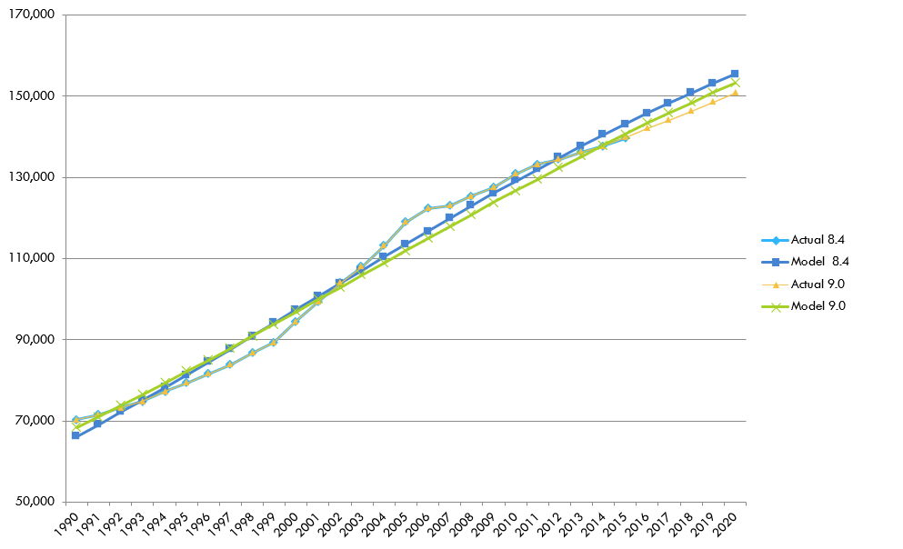
Model Comparisons: Households

Slide 17
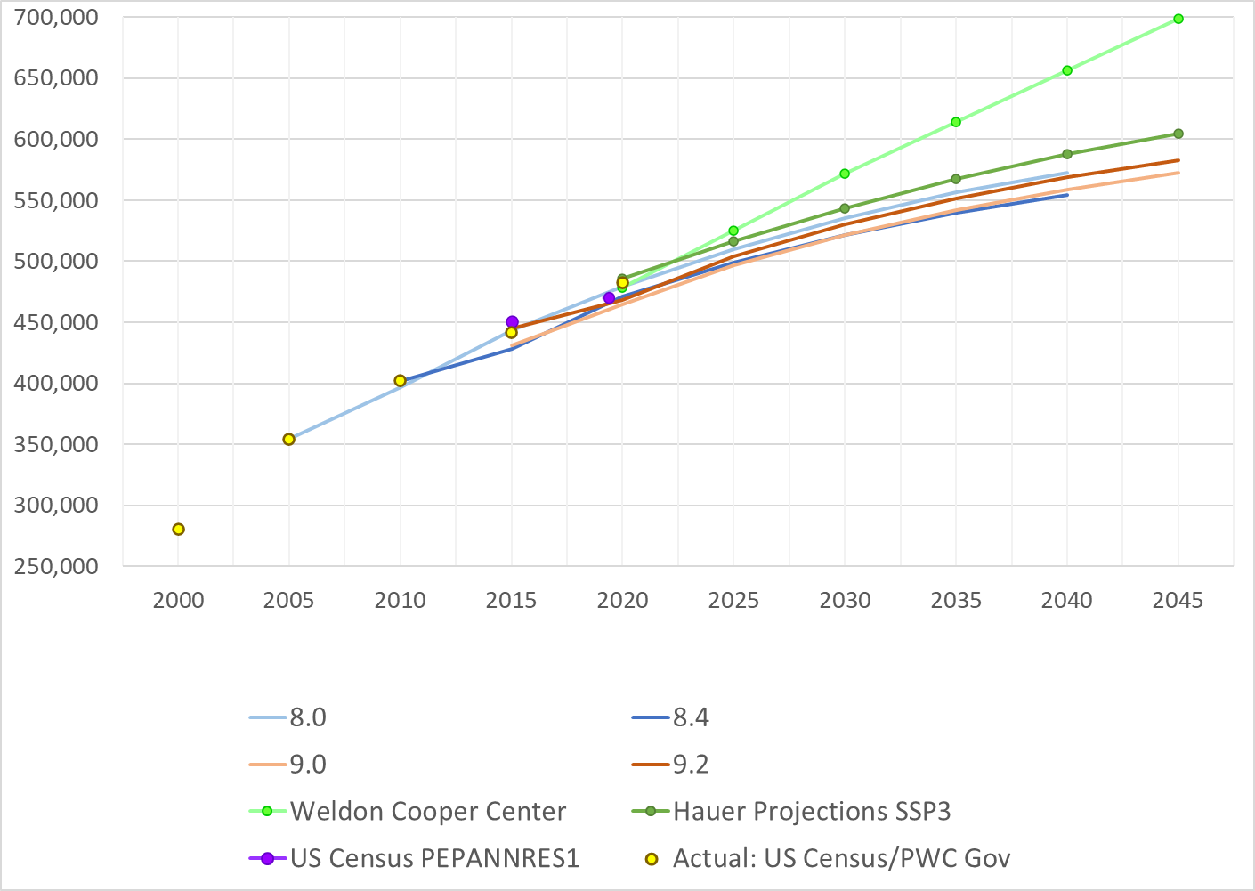
Model Comparisons and Actuals: Population

Slide 18
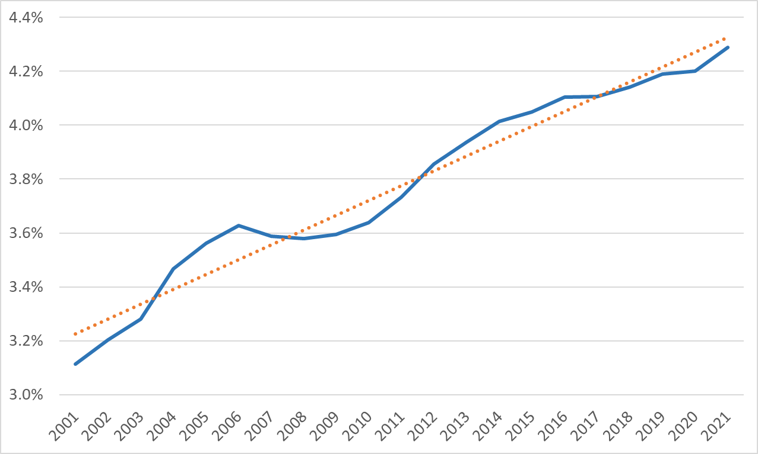
At-Place Employment 2001-2021: PWC as % of MSA
Source: BLS QCEW.
Note: 2021 data is average of quarters 1-3

Slide 19
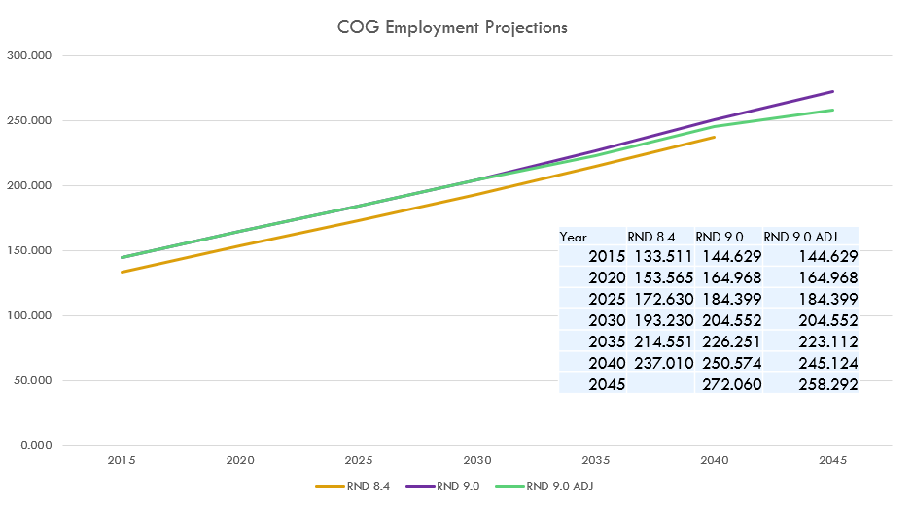
Model Comparison: Employment

