Slide 1
Visitor ORIENTATION
For INDIVIDUALS VISITING the
prince william – manassas Regional adult detention center

Slide 2
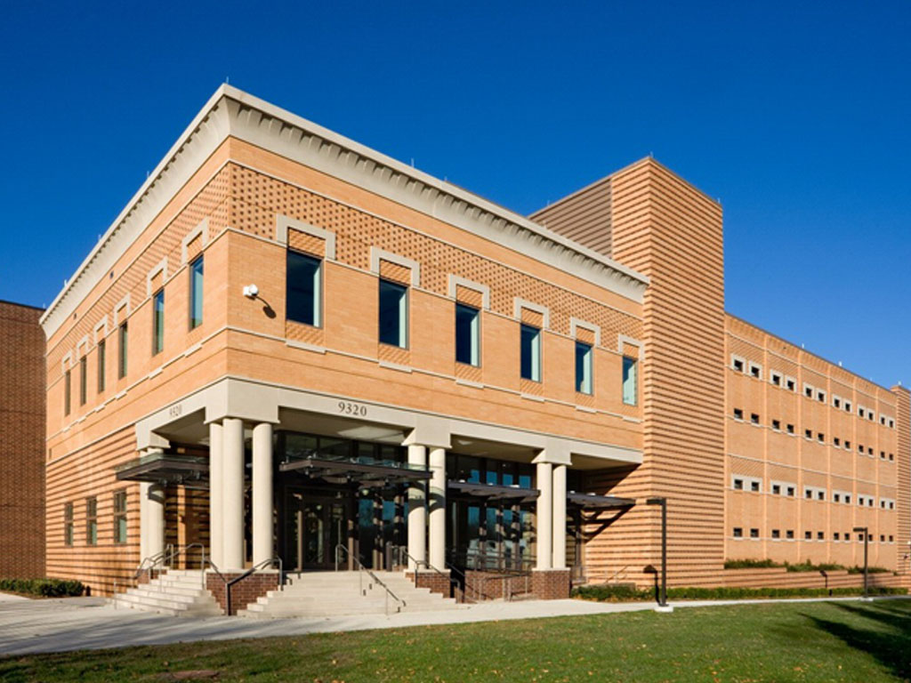
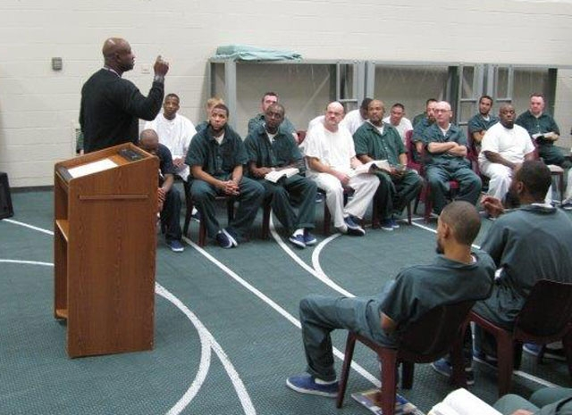
Prince william - manassas regional adult detention center
ADC

Slide 3
Who is this for?
Attorneys
Paralegals
Interns
Employees of other agencies
Community Partners

Slide 4
Objectives
To understand rules, polices and procedures
To assist and guide you for a visit to the ADC
To discuss the importance of security
Opportunity to ask questions

Slide 5
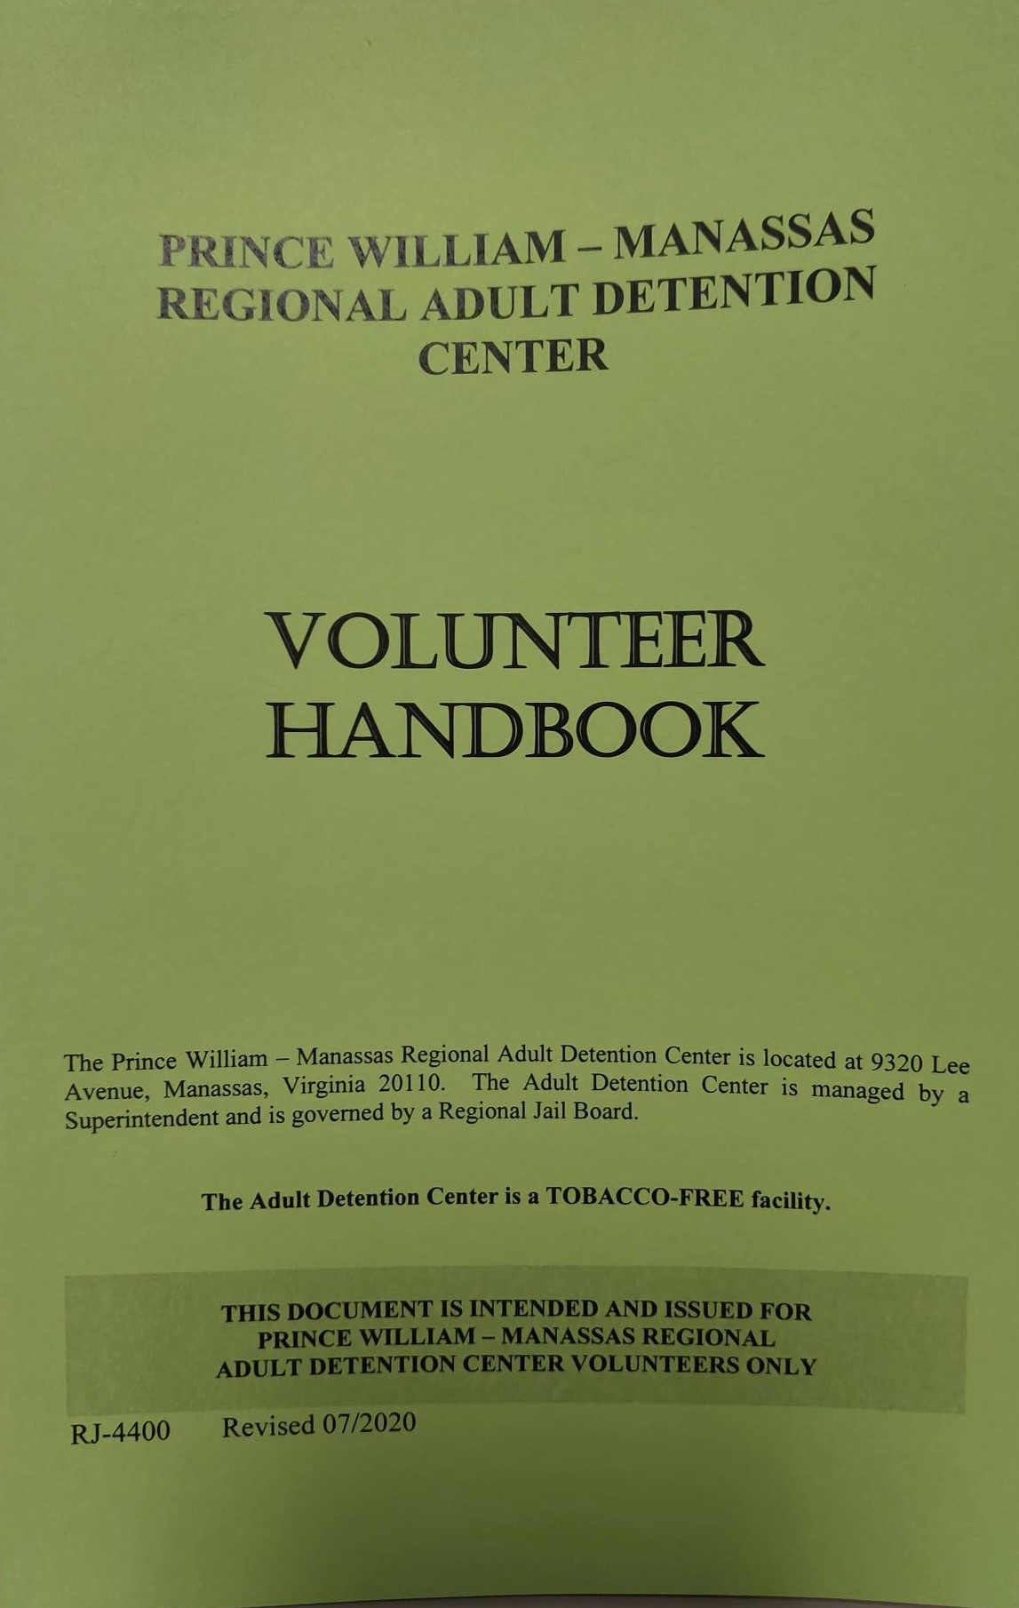
VOLUNTEER HANDBOOK
The volunteer handbook is available for all visitors entering the facility.

Slide 6
The handbook can serve as a reference for:
Program Assignments
Orientation & Training
ID Cards and Admission
Search Policy
Liability
Confidentiality of Information
Chain of Command
Custody Levels and Classification
Security
Contraband
Hostage situations
Fire Procedures
Emergency Situations
Communicable Diseases
Prison Rape Elimination Act (PREA)
Dress Code
Inmate Manipulation

Slide 7
Safety and security
Scheduled activities and visits may be canceled without notice for security purposes.

Slide 8
The adc offers Programs based on
EDUCATION
RELIGION
RE-ENTRY
ADDICTION
FINANCES
AND MANY MORE

Slide 9
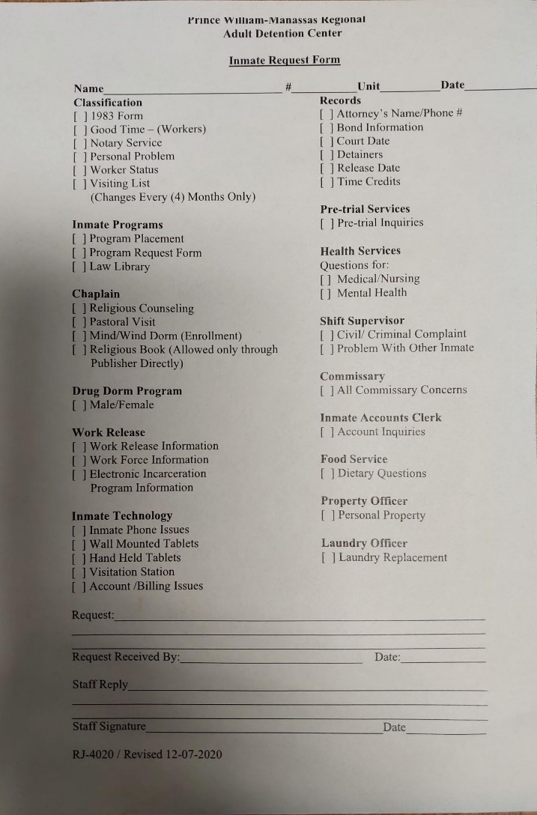
HOW DO INMATES SIGN UP?
INMATE REQUEST FORMS ARE AVAILABLE ON EACH HOUSING UNIT

Slide 10
OPEN PROGRAMS VS. CLOSED PROGRAMS
Open Programs: Available to a specific unit or custody level where the inmates do not need to sign up ahead of time. They can attend and sign in.
Closed Programs: Inmates are required to sign up in advance (request form) and the roster will have specific names on it.

Slide 11
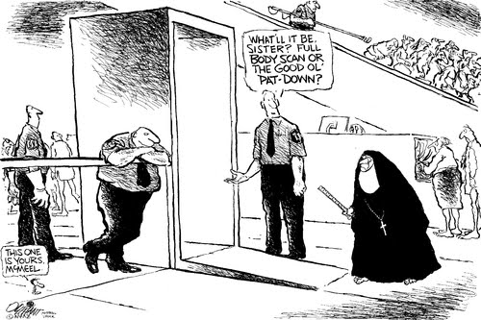
Search policy
ANYONE ENTERING THE JAIL IS SUBJECT TO SEARCH OF THEIR PERSON AND PROPERTY

Slide 12

Liability
No matter the scenario, there is ALWAYS an element of personal risk involved
If you do not feel safe, please INFORM A STAFF MEMBER
Do not hesitate to go with your gut!

Slide 13
Confidentiality of information
“All information concerning inmates is confidential and governed by the Virginia Privacy Act. Do NOT release any information concerning the Detention Center or the inmates to anyone.”

Slide 14
Custody levels
General population
HIGH MAX
LOW MAX
HIGH MEDIUM
LOW MEDIUM
HIGH MINIMUM
LOW MINIMUM

Slide 15
CUSTODY LEVELS CONTINUED
Specialty positions
Trustees/Inside Workers- White Uniform
Female Trustees- Blue Shirt and White Pants
Work Force- Blue Shirt, Khaki Pants
Work Release- Civilian Clothing
EIP- Electronic Incarceration Program

Slide 16
OBJECTIVE JAIL CLASSIFICATION SYSTEM
The ADC has instituted an Objective Jail Classification System. This system represents a balanced approach in how inmates will be classified, housed and their eligibility for privileges within the jail. Objective Jail Classification is an objective process by which inmates are classified and housed based on severity of offense, prior convictions, prior institutional behavior and other validated information.

Slide 17
HIGH MAX
LOW MAX
MURDER, RAPE, CARJACKING, AGGRAVATED ASSULT VICTIM PERMANENTLY IMPAIRED, ESCAPE
HIGH MEDIUM
EXTORTION, GANG PARTICIPATION, BANK ROBBERY UNARMED, CARNAL KNOWLEDGE, EXTORTION
DC SNIPER, EAST COAST RAPIST
LOW MEDIUM
ROBBERY, AGGRAVATED ASSAULT, FELON POSSESSING A WEAPON, COMPUTER SEX OFFENSES, ASSAULT BY MOB
HIGH MINIMUM
BURGLARY, DWI, GRAND LARCENCY, PROBATION VIOLATION, VANDALISM, VIOLATION OF PROTECTIVE ORDER
LOW MINIMUM
FAIL TO PAY CHILD SUPPORT, DRIVING WITHOUT LICENSE, TRESPASSING

Slide 18
Security
NEVER BRING ANYTHING INTO THE ADC FOR AN INMATE (this does not include legal papers)
Never carry messages in or out of the ADC for inmates. (personal messages)
Never give ANYTHING to an inmate without prior approval.
Follow instructions promptly and never argue with the security staff.

Slide 19
Contraband
“Anyone who knowingly brings illegal contraband (weapons and/or controlled substances) into this Detention Center will be prosecuted to the fullest extent of the law.”

Slide 20
contraband
The definition of contraband in this facility is anything that is NOT:
Purchased in the Commissary.
Issued by the Detention Center.
Accepted through the admission procedure.

Slide 21
WANT OR NEED?
There is not a single item that the inmates NEED that the jail does not provide. Balanced diet, television, tablets, phones, visits (contact & video), recreation, beds, toilets, sinks, showers, clothes, sheets, blankets, education, soap, combs, books, pens, envelopes, paper, a law library, access to courts and attorneys.

Slide 22
TO ELABORATE:
Commissary is optional- Inmates may buy a variety of items such as notebooks, radios and snacks
All items for basic life needs are provided at no additional cost
All items not provided by the ADC must have prior approval
ALL UNAPPROVED ITEMS ARE CONSIDERED CONTRABAND!

Slide 23

IN THE EVENT OF AN ALTERCATION
IMMEDIATELY LEAVE THE ROOM
INFORM THE NEAREST STAFF MEMBER
DO NOT PARTICIPATE OR TRY TO INTERVENE

Slide 24
Hostage SITUATION
Employees or visitors who may be taken hostage by inmates for the purpose of escape or disruption of ADC operations shall not be recognized as hostages for bargaining purposes.
Appropriate staff shall be trained in the handling of hostage situations
The safety of the staff, the hostages, and the public is of prime concern.

Slide 25
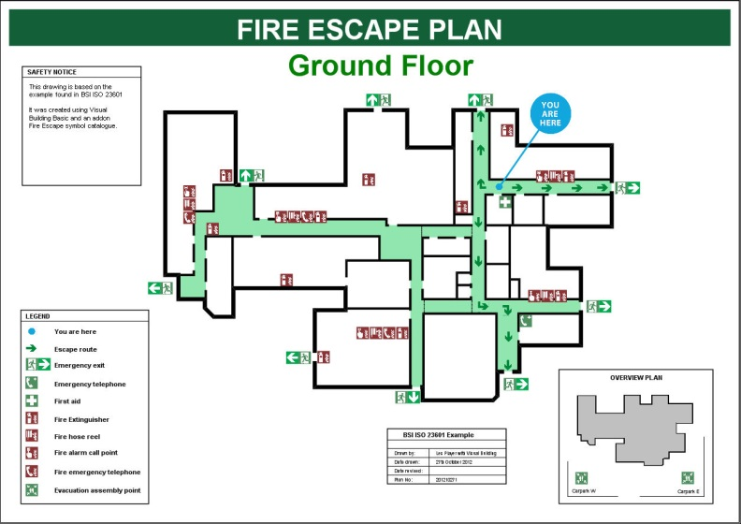
Fire procedures
Fire escape routes posted in every area of the jail
Stay calm and follow instructions

Slide 26

SOME EXAMPLES OF REQUIRED REPORTING
Fights
Inappropriate behavior
Personal knowledge of an inmate

Slide 27
Emergency situations AND ON SITE INJURIES
Inform the nearest staff member of any injury or emergency situation.
Complete a written report of the facts relating to the situation.
Give the report to a supervisor on duty.

Slide 28

Communicable diseases
If you are sick, please do not come into the ADC. It is ok to cancel.

Slide 29

WHAT IS THE DRESS CODE?

Slide 30
Clothing requirements
NO low-cut shirts
Shirts must have sleeves
NO crop tops
NO tanks top
NO shorts
NO skirts or dresses above the knee (including when you are sitting down)
NO see-through clothing
NO leggings
NO spandex
NO yoga pants

Slide 31
Clothing REQUIREMENTS continued
NO clothing with offensive language and symbols
NO open-toed shoes (e.g. flip flops, sandals)
No open back shoes
No high heeled shoes over 2 inches
NO scarves
NO hats (of any kind)
No heavy dangly jewelry
Stud type earrings only

Slide 32

Professional Ethics

Slide 33

Prison Rape Elimination Act (PREA)
No such thing as consensual sex with an inmate!
Zero Tolerance of sexual abuse
You are a person of trust/authority
Unprofessional relationships will not be tolerated.
Duty to report PREA violations

Slide 34
KEEP BOUNDARIES WITH INMATES
IT IS IMPORTANT TO MAINTAIN A PROFESSIONAL RELATIONSHIP WITH INMATES.

Slide 35

You are a visitor, they are inmates!

Slide 36
Questions?
I am available for any questions.
Thank you!
Sgt. McDonald – Inmate Programs Coordinator
703-792-6429, kmcdonald@pwcgov.org

