Slide 1
Hypothermia Services
Prince William Area CoC
(PWA CoC)
October 3, 2024

Slide 2
AGENDA
What is Hypothermia?
Warning Signs of Hypothermia
Frostbite & Hypothermia
CDC Hypothermia Information Link
Hypothermia Season Timeframe
Hypothermia weather
Hypothermia providers
Coordinated Entry System Role & Responsibilities
Q&A

Slide 3
What is hypothermia?
Hypothermia is caused by prolonged exposures to very cold temperatures. When exposed to cold temperatures, your body begins to lose heat faster than it’s produced. Lengthy exposures will eventually use up your body’s stored energy, which leads to lower body temperature.

Slide 4
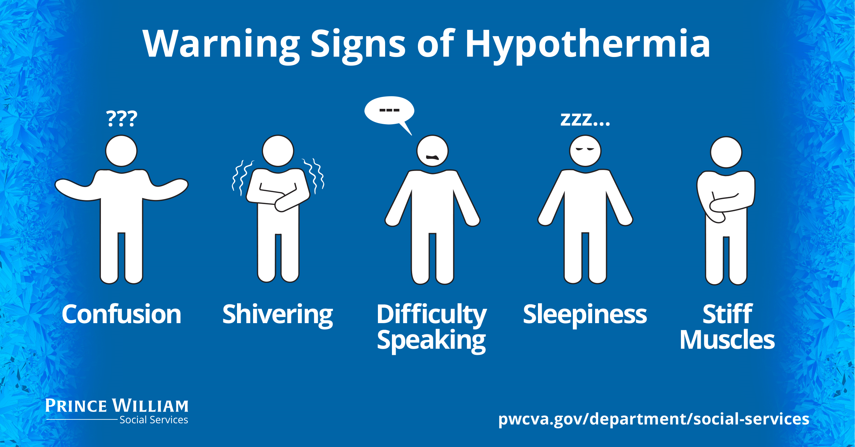
Warning Signs

Slide 5
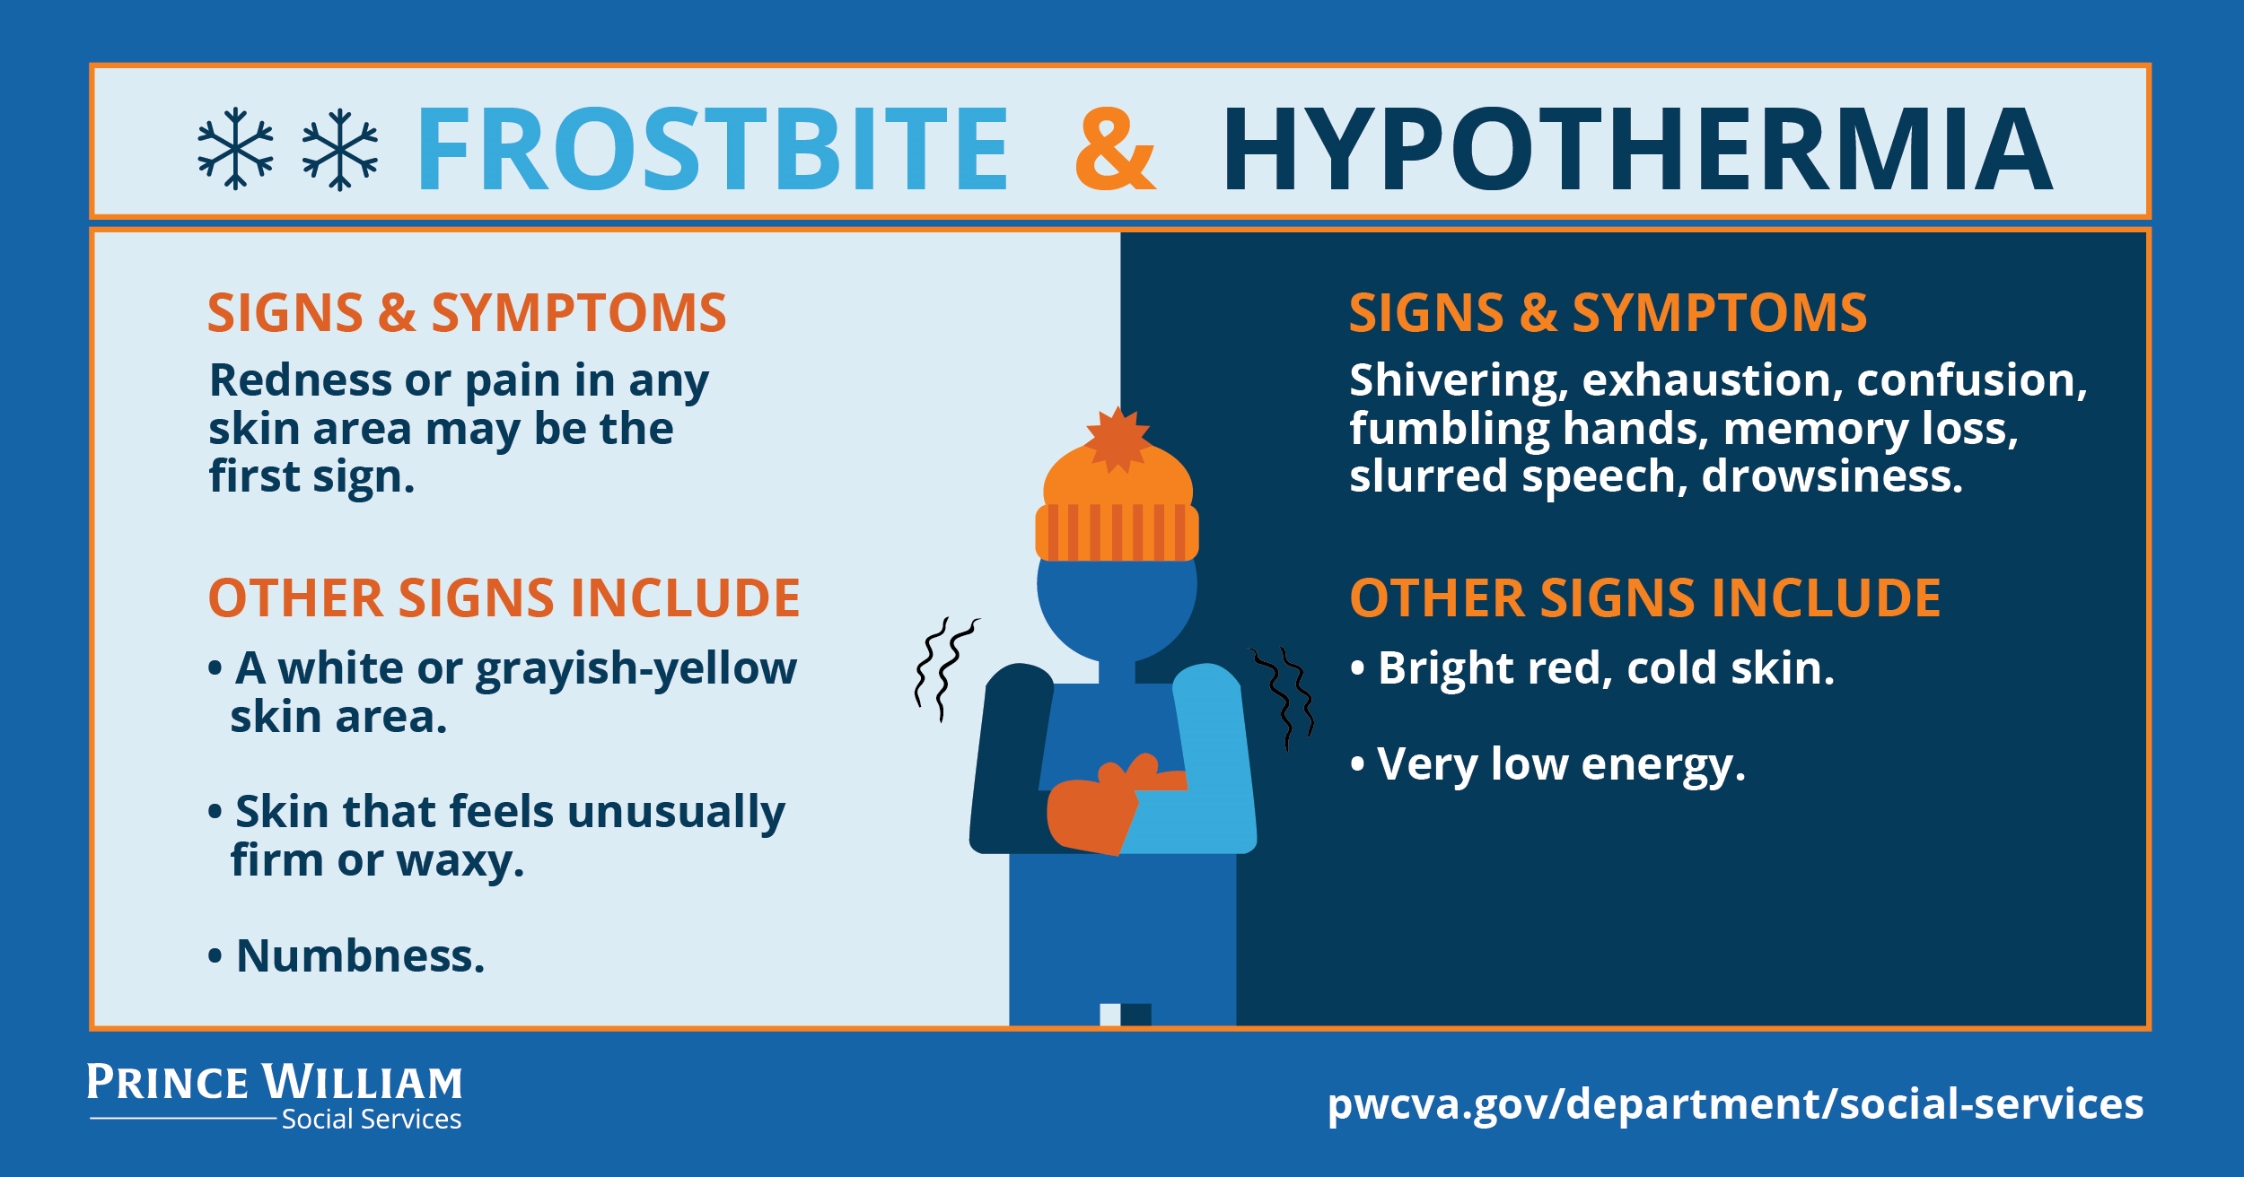
Frostbite & Hypothermia

Slide 6

CDC Hypothermia Information Link
https://www.cdc.gov/disasters/winter/staysafe/hypothermia.html

Slide 7
Hypothermia Season timeframe
  Starts: November 1, 2024
  Ends: March 31, 2025

Slide 8
Hypothermia weather
  When temperatures will be 32 degrees or below and considering the wind chill factor

Slide 9
Hypothermia Providers
  East (StreetLight Ministries) – open the entire hypothermia season, Monday – Sunday.
  West (Manassas Baptist Church) – When temperatures will be 32 degrees or below and considering the wind chill factor.

Slide 10
Coordinated Entry Services
  CES Overall Role - Notifications
  CES will send out a hypothermia services notification two times per week (Sundays & Thursdays).
  Provide information about hypothermia services. We will encourage clients and providers to call the hypothermia programs during their operating hours.
  If you wish to be added to the hypothermia weather report, please email dsshypo@pwcgov.org

Slide 11

Questions & Answers

