Slide 1

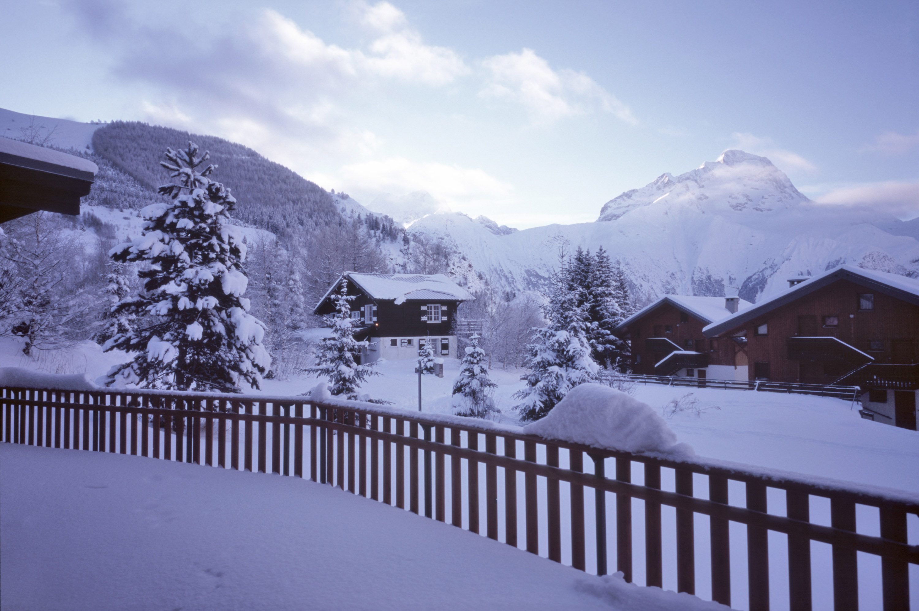
Hypothermia Shelter
Operating Plan

Slide 2
Hypothermia Program Prince William County East
Operated by StreetLight Community Outreach Ministries and Partners

Slide 3
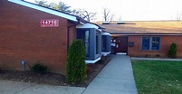
Timeline: November 01, 2024 to March 31, 2025
Location:
Bill Mehr Drop In Center(DIC)
14716 Potomac Mills Road
Woodbridge, VA 22192
703-227-7140(6 pm-7:30 am)

Slide 4
Who We Serve:
We welcome single adults and adult-only households who are experiencing homelessness and seeking shelter. For households with minor children, please contact the Coordinated Entry System (CES)during operation hours at 703-792-3366. After hours please call CES to receive instructions recorded on the voice mail.
Individuals who are actively under the influence of a substance or actively experiencing mental health concerns are welcome. Staff will evaluate the individuals’ present state/behavior with regards to the safety of all other guests and staff.
Individuals must be able to perform their daily living activities( such as walking, dressing, bathing, use of restroom, and eating) without assistance.

Slide 5
When Are We Open?
The hypothermia shelter will be open every night, regardless of temperature.
We are in operation from 6pm – 7:30 am.

Slide 6
Facility and Services We Offer:
We have availability for 22 individuals; 8 females, 14 males. Separate sleeping quarters are provided for females and males. We can serve up to 7 additional individuals by offering a chair during very cold nights.
Showers are available
Office with around the clock supervision
Dining area, serving dinner and breakfast

Slide 7
How we operate the program
Walk Ins only. No referral process this season!
Individuals are allowed to line up at 5:45pm (not before)! First come, first serve. Individuals must be present to receive a number (1-22) in order to reserve a bed. Reserving a space for a friend or leaving personal belongings as place holder is not allowed!
Hypo staff has other shelter vacancy lists available, in case we reach capacity.
Service Providers and Outreach staff, please inform your clients on a regular basis about hours of operation.
Hours of operation will be posted on StreetLight’s website, and on our Facebook page.

Slide 8
Transportation Process:
Individuals will have to provide their own transportation or take public transportation to the Drop-In-Center. NOTE: Buses are free, and the bus depot is very close by.
Late night transportation or transportation arrangements from one shelter to another will be
arranged as follows: The referring provider will schedule transportation to the receiving
provider if funding is available.

Slide 9
Point of Contact/Resources
CES: 703-792-3366
StreetLight: 703-227-7140(6pm-8am)
Email: thermalshelter@thestreetlight.org (will be checked several times between 6 pm and 8 am)
For more information
StreetLight Facebook:
https://www.facebook.com/streetlightoutreach
County website:
https://www.pwcva.gov/department/social-services/hypothermia-shelter-services
Resources for daytime facilities:
https://www.pwcva.gov/department/library

Slide 10
Questions

